Slide 1
Welcome
Hello everybody, It’s me Bibek Chand Sah. Today I am going to give a presentation on the topic Effect of AI in present age.

Slide 2
EFFECTS OF ARTIFICIAL INTELLIGENCE IN PRESENT AGE

Slide 3
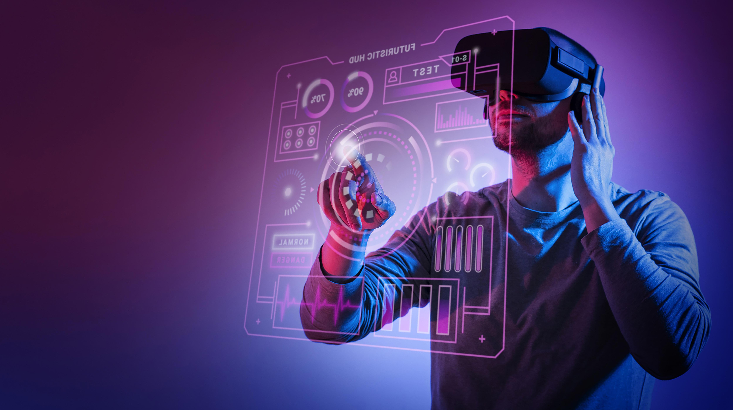
Introduction
Artiﬁcial Intelligence (AI) refers to the ability of machines to perform tasks that would typically require human intelligence. This presentation focuses on how AI is impacting various industries and changing the way we live and work.

Slide 4
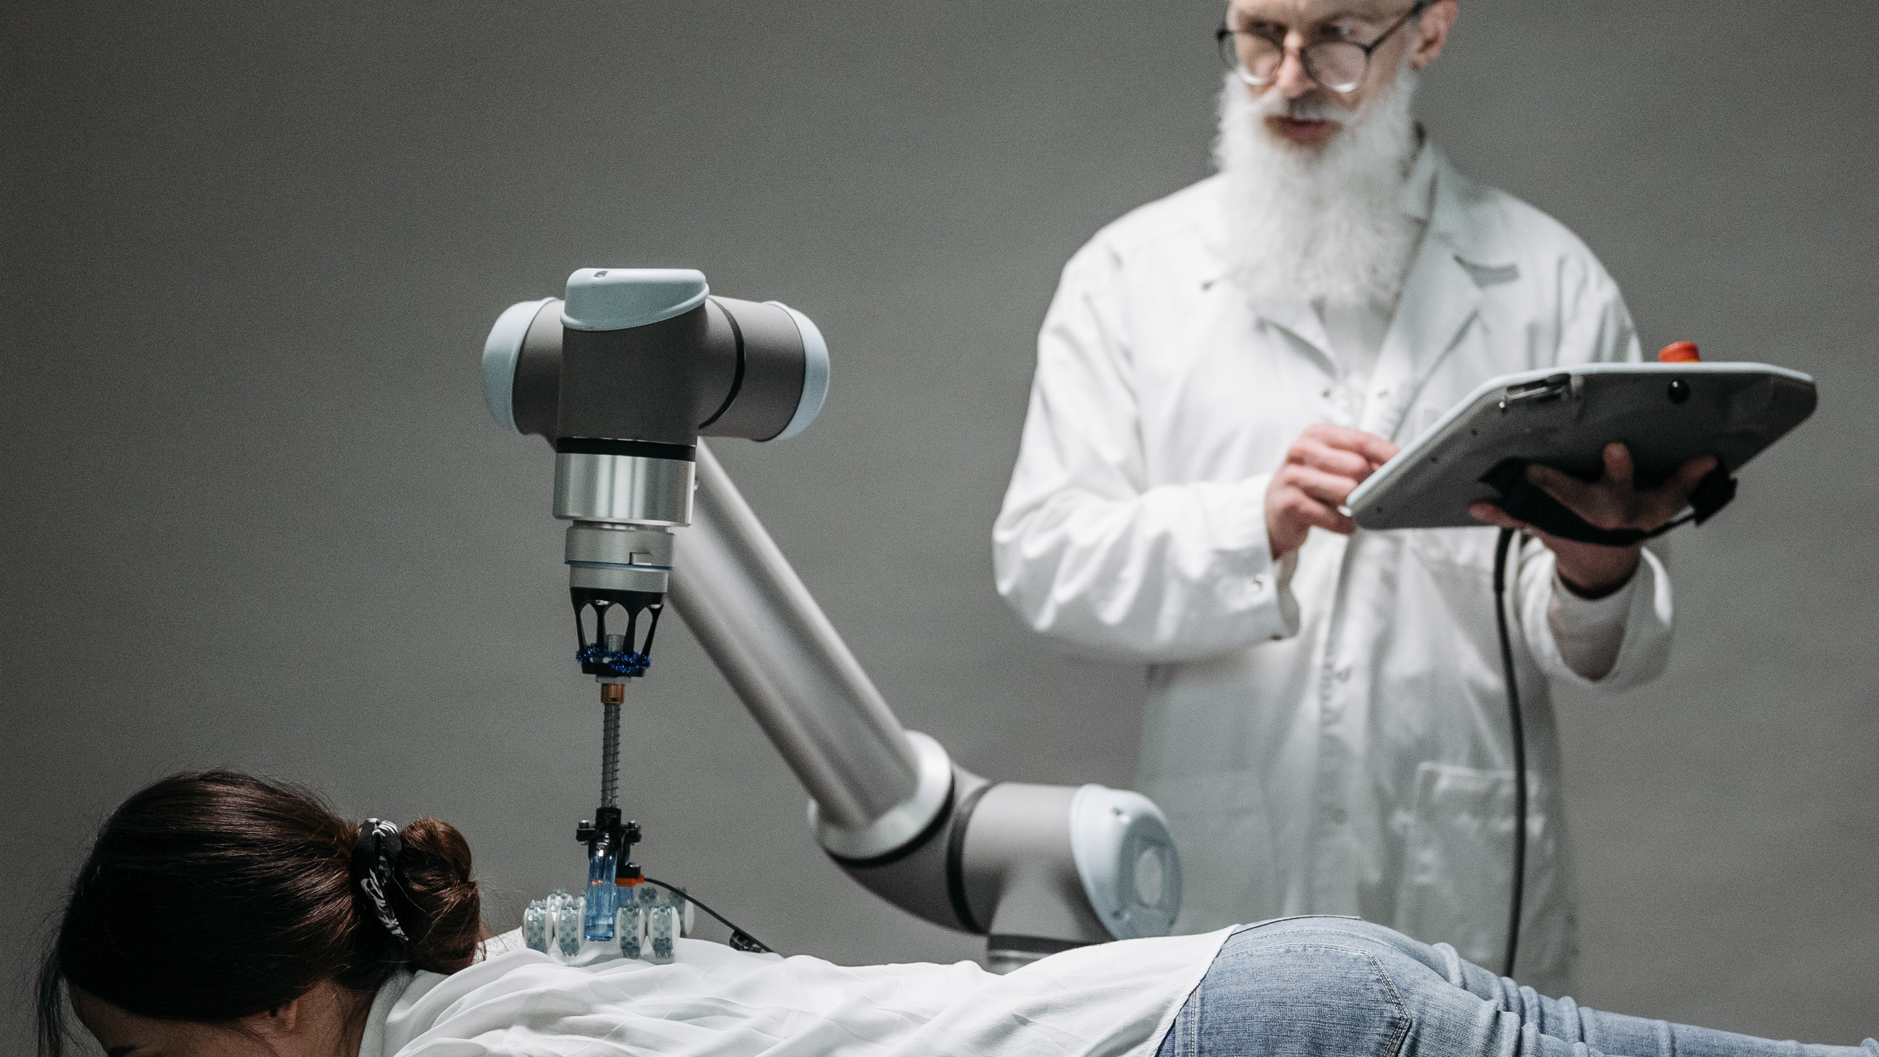
AI in Healthcare
AI is revolutionizing healthcare by analyzing large amounts of medical data to identify patterns and provide accurate diagnoses. It's also improving patient outcomes by enabling personalized treatment plans and predictive analytics that can anticipate and prevent diseases.

Slide 5
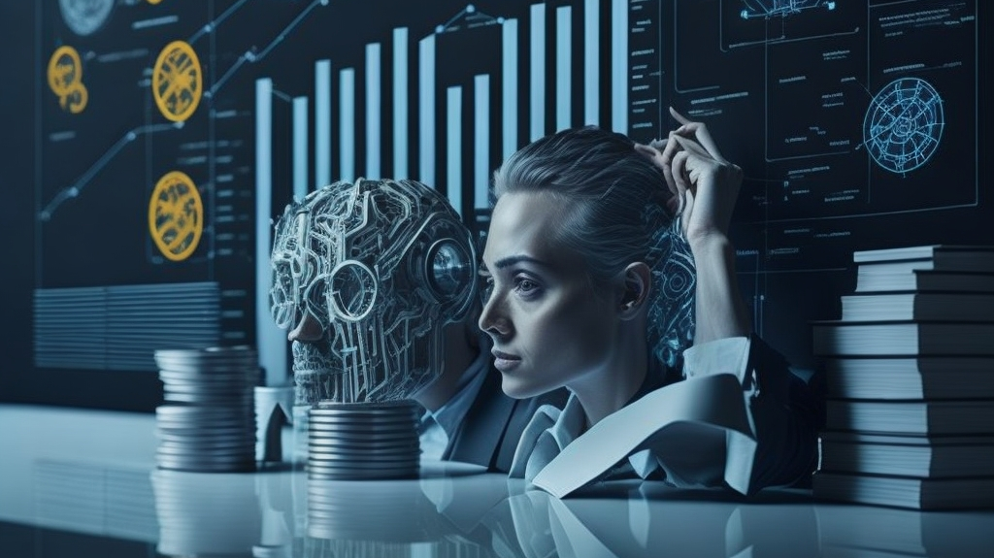
AI in Finance
AI is transforming the ﬁnance industry by automating mundane tasks and providing real-time fraud detection. It's also improving customer experience by providing personalized ﬁnancial advice and chatbots that can assist customers 24/7.

Slide 6
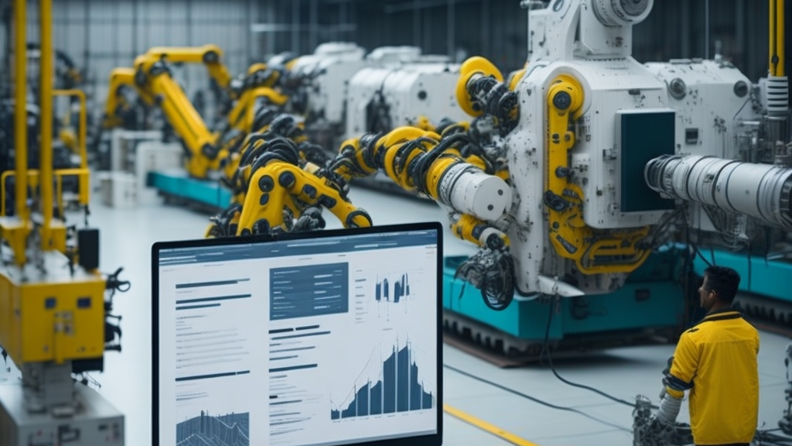
AI IN MANUFACTURING
AI is changing the manufacturing industry by optimizing supply chain management and predictive maintenance. It's also enabling smart factories that can operate with minimal human intervention and improve production efﬁciency.

Slide 7
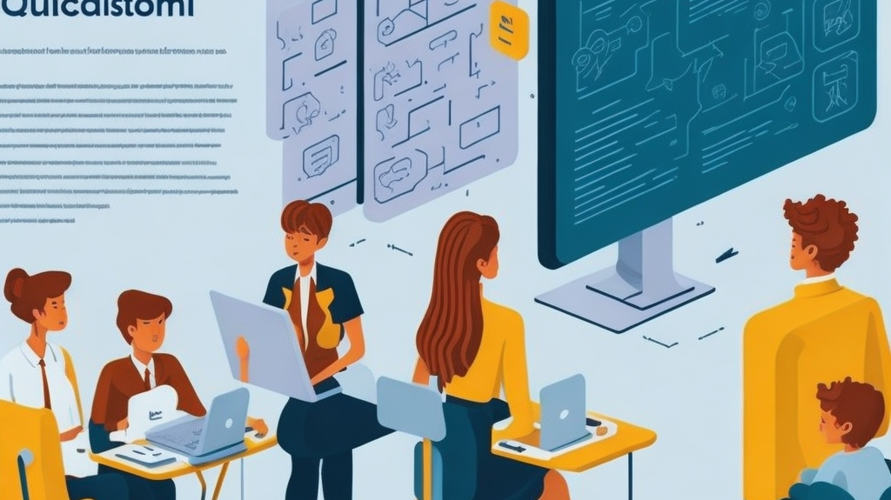
AI IN EDUCATION
AI is transforming education by providing personalized learning experiences and adaptive assessments that can identify student strengths and weaknesses. It's also improving accessibility by providing assistive technology for students with disabilities.

Slide 8
CONCLUSION
Artiﬁcial intelligence is changing the world as we know it. It's improving efﬁciency, accuracy, and customer experience across various industries. However, it's important to ensure that AI is developed ethically and with human values in mind. We must use AI to augment human abilities rather than replace them.

Slide 9

Any Quires

Slide 10


